Slide 1

Fake News Identification in Social Media
Project by :-
Amisha Jain
Moin Khan
Rishi Chouhan

Slide 2


Introduction
We propose a mechanism for detection of such misinformation being spread on message sharing platforms as it has recently become an important issue to resolve.
Our proposed mechanism doesn’t intent to stop spreading of fake news or misinformation instead it makes the user aware of authenticity of information.

Slide 3

Problem Statement
To implement a mechanism for detection of misinformation being spread on message sharing platforms to avoid extremely negative impacts on individuals and society.

Slide 4

Objectives
To give the user a provision of verifying information received.
To make user aware of the forwarded information received is fake or not.
To avoid spreading of misleading information among society.
Hence to avoid extreme negative impacts on the society due to spread of misinformation.

Slide 5

Motivation
Malicious users.
During natural disasters or crises.
Spread lies and misinformation.

Slide 6
Literature Survey
Title | Publication | Author | Techniques / Key Points
[1] Classifying Fake News Articles Using Natural Language Processing to Identify In-Article Attribution as a Supervised Learning Estimator. | 2019 IEEE 13th International Conference on Semantic Computing (ICSC) | (1) Terry Traylor U.S. Marine Corps Fargo, ND. (2) Jeremy Straub, Gurmeet, Nicholas Snell North Dakota State University Fargo, ND. | Fake News. Machine Learning, Natural Language Processing, Attribution Classification, Influence Mining.
[2] Message Authentication System for Mobile Messaging Applications. | 2017 International Conference on Next Generation Computing and Information Systems (ICNGCIS) | (1) Ankur Gupta, (2) Purnendu Prabhat, (3) Rishi Gupta, (4) Sumant Pangotra Suave Bajaj. | Message Authentication, fake news, veracity Assessment. Sentiment analysis.
[3] Credibility Assessment of Textual Claims on the Web. | Proceedings of the 25th ACM International on 2016. | (1)Kashyap Popat, (2)Subhabrata Mukherjee, (3)Jannik Strötgen, (4)Gerhard Weikum, Max Planck Institute for Informatics Saarbrücken, Germany | Credibility Analysis, Rumor and Hoax Detection, Text Mining. Distant supervision.
[4] Fake and Spam Messages: Detecting Misinformation during Natural Disasters on Social Media. | 2015 IEEE/WIC/ACM International Conference on Web Intelligence and Intelligent Agent Technology. | Meet Rajdev and Kyumin Lee, Department of Computer Science Utah State University Logan, UT 84322. | Fake, spam, social media, detection. Flat and hierarchical classification.

Slide 7
Literature Survey
Paper | What? | Where?
Message Authentication System for Mobile Messaging Applications. | Architecture of System Text Preprocessing method | Data Preprocessing
Credibility Assessment of Textual Claims on the Web. | Data fetching from Search Engine Source reliabilty | Alternative to collect data from Search Engine
Siamese Recurrent Architectures for Learning Sentence Similarity | LSTM for text similarity | For score generation

Slide 8
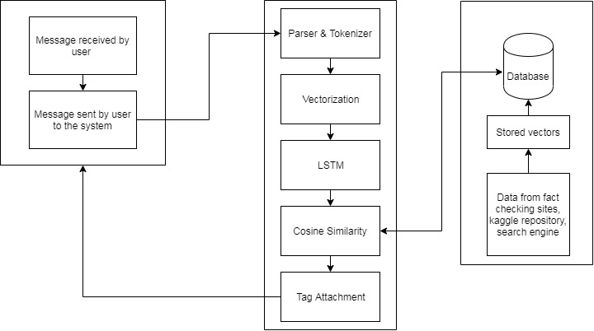
Block Diagram

Slide 9
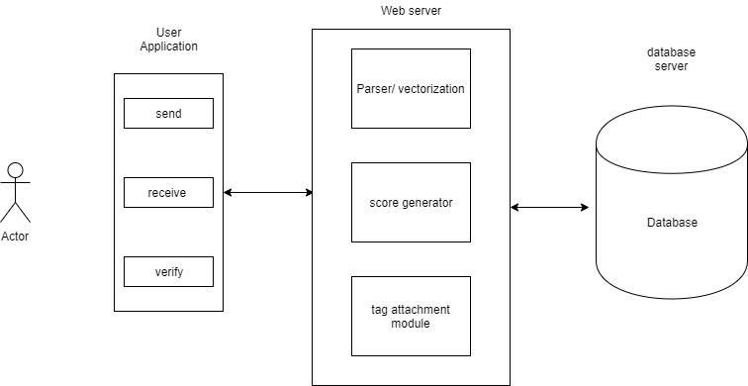
Architecture Overview

Slide 10
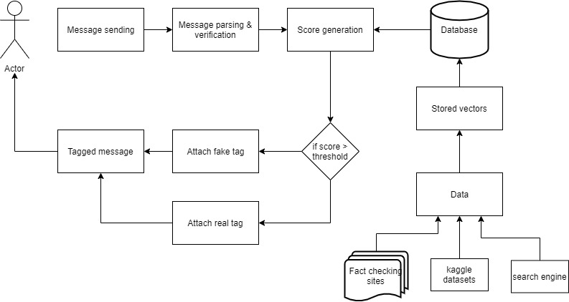
Flowchart

Slide 11
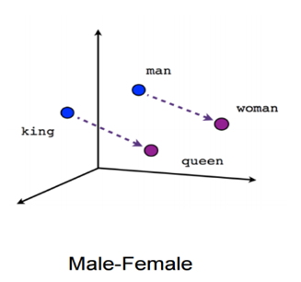
Word2Vec
Word2vec -
method to represnt the words in vector form.
Finds embedding between the words.
Queen = King - Man+woman

Slide 12
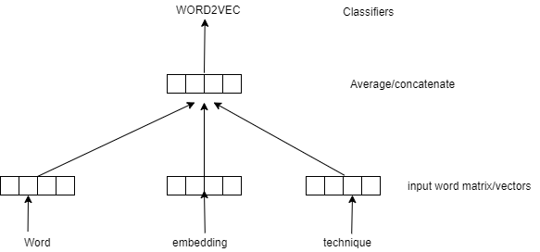
CBOW
Continuous bag of words.

Slide 13
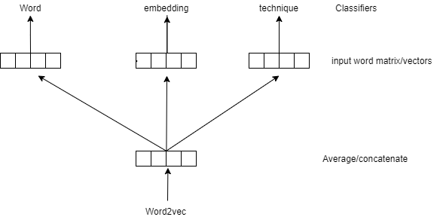
SKIP GRAM

Slide 14
Doc2Vec
-Extension to word2vec ,creates vector for whole documents.
-Attach unique tag id to each documents.
DOC2VEC = word2Vec

Slide 15
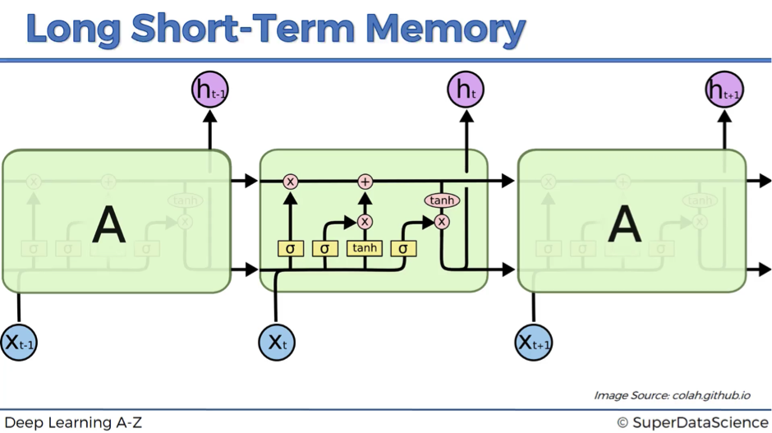
Long Short-Term Memory
Long short-term memory (LSTM) is an artificial recurrent neural network (RNN) architecture.
>Input Gate ----- sigmoid
>Forget Gate ----- tanh
> Output Gate ----- sigmoid

Slide 16
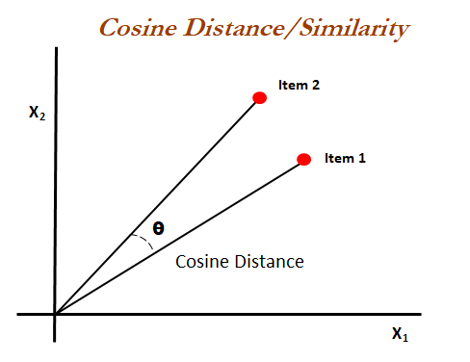
Cosine Similarity
Cosine similarity is a metric used to measure how similar the documents are irrespective of their size. Mathematically, it measures the cosine of the angle between two vectors projected in a multi-dimensional space.

Slide 17
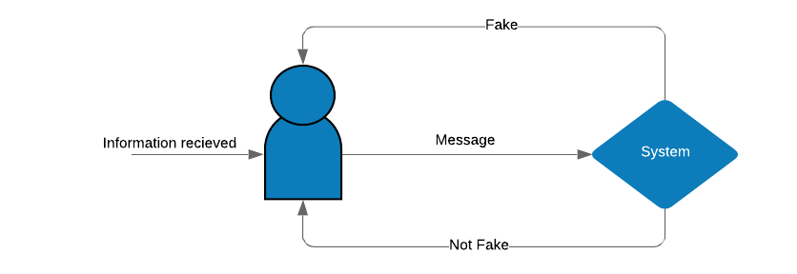
End User
Any user having a message sharing application is susceptible to misinformation all such users are end users of this Fake news Detection system in social media.
Politicians, fake organizations and companies tend to spread information which the common man acting as our end-user can verify the information using system.

Slide 18
Requirements within the scope of project
Functional Requirements :-
Detection of information received by the end user and verifying its correctness.
Attachment of “fake” tag in-case of misinformation received by the user.
Non-functional Requirements :-
Database security
User’s privacy

Slide 19

Scope
The scope of our project is to consider message/information in a specific text format an further detect the given piece of information as real or fake.
Our proposed system gives user the privilege of verifying the received information is fake or real.
Therefore the system creates an obstruction for spreading of misinformation which encourages communal differences.

Slide 20
Project’s Viewpoint
This project, after its development would be able to allow users to verify the correctness of the information received.
This system henceforth provide an obstruction for spreading of fake news.
News
Real
Fake

Slide 21

How it’s going to work ?
Our system gives the user to have the authority to verify whether whatever he/she has received is real or fake.
This system which creates datasets by collecting data from different sources which finds the relation between the entities present in the user's message.
Then a predictor is there to label the message whether it's fake or not.
At last, a tag(fake or real) is attached to the message before returning message to user.

Slide 22
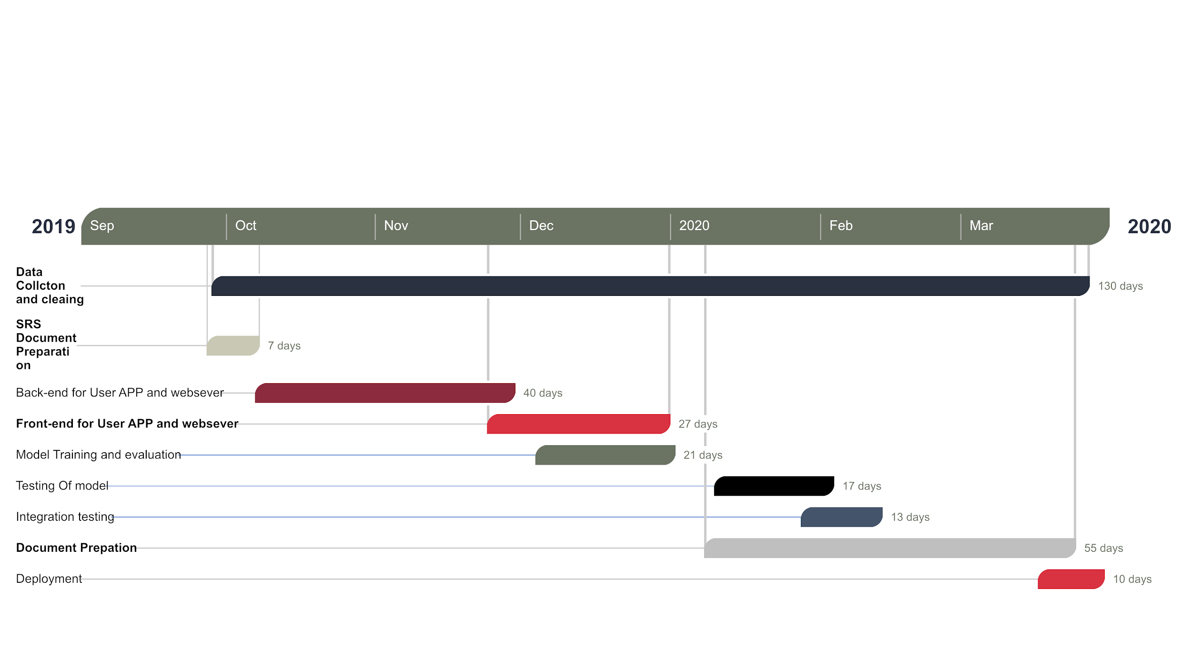
Project Timeline

Slide 23
Feasibility Analysis
Data Feasibility :-
Data Availability
Data Reliability
Data Extractability
Algorithm Feasibility :- The main aim while classifying the message/information is to find its context.
parser - NLP
vectorizer - word2vec + LSTM
similarity between vectors - cosine similarity

Slide 24
Mathematical Model
S = { Input,function = M1,M2,M3 ,M4,M5, Output}
INPUT -
User Message
format - text
FUNCTION -
M1-text processor
M2 - word2vec
M3 - LSTM
M4-Cosine Similarity
M5-Tagged Message
OUTPUT: Tagged Message
format - text + tag
M1= { I= user message ,F = text processor,O- cleaned text}
M2= { I = M1.O ,F = word2vec,O- word vector}
M3= { I = M2.O ,F = LSTM,O- sentence vector}
M4= {I= M3.O ,F =cosine similarity ,O- number between 0 -1}
M5= { I = M5.O ,F = tag attacher ,O- tagged message}

Slide 25
Idea Matrix
IDEA | DELIVERABLE | PARAMETERS AFFECTED
Increase | It increases user awareness about the received information. It make better bandwidth utilization. | Performance Bandwidth utilization
Improve | It improves message authentication. Improves bandwidth utilization | Social Impact Bandwidth
Ignore | It ignores the self-influence based on pre-existing content | Storage

Slide 26
Drive | Regular updation of data. Secure and consistent data | Data updation
Deliver | It delivers an efficient message sharing system which verify the correctness of an information. | Relevant data
Decrease | Decreases the spread of information. Decrease the cost of data storage. Decreases data redundancy. | Social and communal riots. Cost Data Storage

Slide 27
Educate | Educate project members. Educate user | Project Members User
Evaluate | Continuous monitoring and analysis of information to smoothen message sharing platforms. | Shared memory
Eliminate | Eliminates duplication of data | Storage space

Slide 28
Accelerate | Helps in quick data updation and modification. Message Authenticity | Data Storage
Avoid | Avoid Creation,Publication and Propagation of misinformation. Avoid storage of duplicate data in the database | Storage space on database

Slide 29
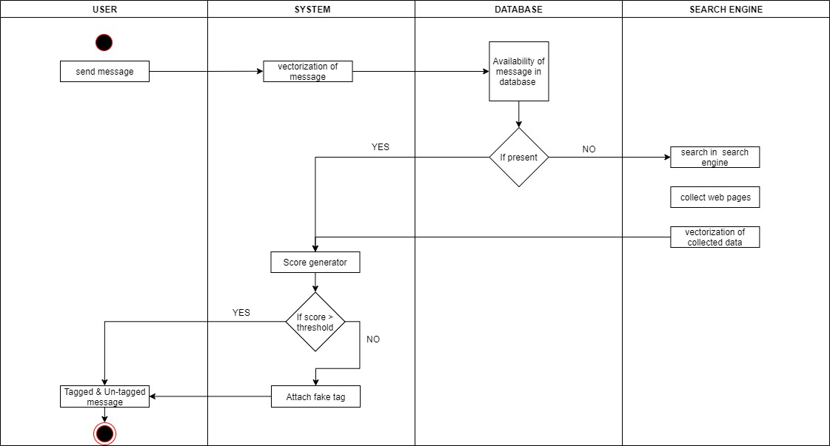
Activity Diagram

Slide 30
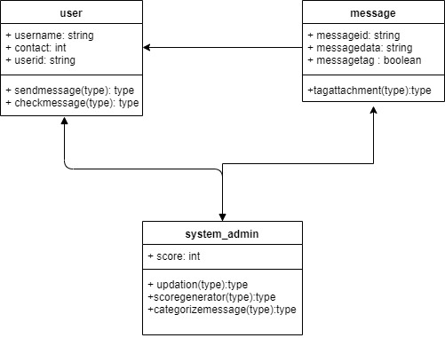
Class Diagram

Slide 31
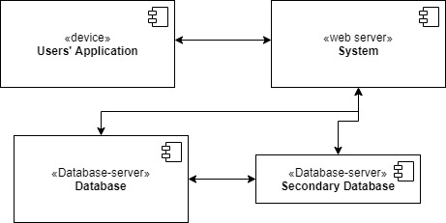
Deployment Diagram

Slide 32
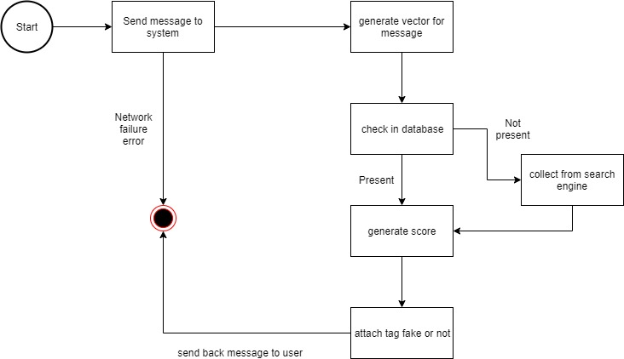
State Diagram

Slide 33
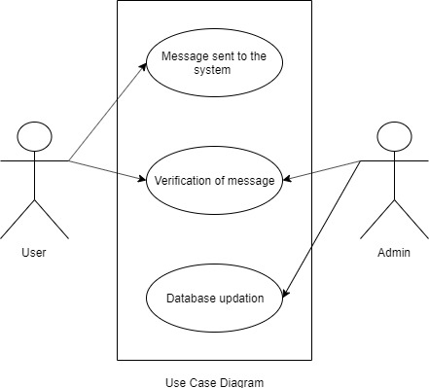
Use Case Diagram

Slide 34
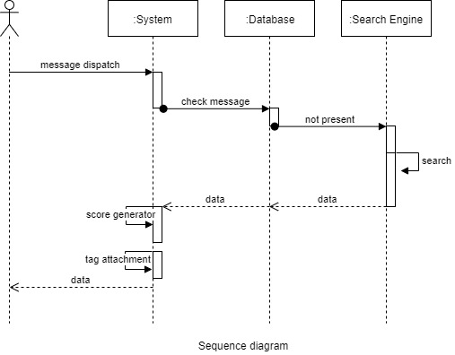
Sequence Diagram

Slide 35
Risk Analysis
Technical Risks :- Database crash, database updation failure, Network traffic.
Operational Risks :- System failures leads to wrong identification of message/information and can cause spreading of wrong content.
Schedule Risks :- Starting too slow(not finishing in time), Rushing(ignoring quality of system and completing before deadline).
Business Risks :- Availability of same kind of system in the market.

Slide 36
Risk Prioritization & Backup Plan
Primary plan - searching in database
Backup plan - searching in search engine
Primary plan - use data available in database
Backup plan - use the secondary duplicated database in case the primary database crashes.

Slide 37
Conclusion
Fake news circulation is emerging as a major problem on all social media and message sharing platform with several side effects hence we propose a system which would help in solving the problem.
The requirements which demand the identification of context of the information which is fulfilled by parsing and vectorizing algorithm explained above. Finally calculating similarity between user request message and pre stored data in database we can successfully implement the system.

Slide 38
References
•[1] Classifying Fake News Articles Using Natural Language Processing to Identify In-Article Attribution as a Supervised Learning Estimator. Traylor, T., Straub, J., Gurmeet, & Snell, N. (2019). Classifying Fake News Articles Using Natural Language Processing to Identify In-Article Attribution as a Supervised Learning Estimator. 2019 IEEE 13th International Conference on Semantic Computing (ICSC), 445-449.
•[2] Message Authentication System for Mobile Messaging Applications. Gupta, Ankur & Prabhat, Purnendu & Gupta, Rishi & Pangotra, Sumant & Bajaj, Suave. (2017). Message Authentication System for Mobile Messaging Applications. 147-152. 10.1109/ICNGCIS.2017.32.
•[3] Credibility Assessment of Textual Claims on the Web. Credibility assessment of textual claims on the webK Popat, S Mukherjee, J Strötgen, G Weikum - Proceedings of the 25th ACM International on, 2016.
•[4] Rajdev, M., & Le, K. (2015). Fake and Spam Messages: Detecting Misinformation During Natural Disasters on Social Media. 2015 IEEE/WIC/ACM International Conference on Web Intelligence and Intelligent Agent Technology (WI-IAT), 1, 17-20.

Slide 39
Thank You !!

